Slide 1
Makeathon 2022
Idea Submission

Slide 2
TECH WIZARDS
Palak Mangla - Indira Gandhi Delhi Technical University for Women
B.tech in Artificial intelligence and Machine Learning
Email: palakmangla40@gmail.com Samriddhi Sharma – Dayanada Sagar College Of Engineering
B.E in Artificial Intelligence and Machine Learning
E-mail: samriddhisharma710@gmail.com
THEME:
[AUTOMATED FINANCIAL PLANNING]

Slide 3
PROBLEM STATEMENT
Develop an automated financial planning system aimed at predicting the profit for an individual based on their income, time period, and risk tolerance. The system should recommend optimal investment allocations across various asset classes, including real estate, fixed deposits, stocks, gold, and cash in the bank, to maximize the user's profit within the given time frame. The system should utilize historical data on gold prices, stock prices, fixed deposit rates, and real estate market trends to forecast the future prices of these assets at the end of the specified time period. It should calculate the expected returns and risks associated with each investment option, generate personalized investment recommendations based on user input, and calculate the expected profit percentage for each investment category and the total profit at the end of the given time period.

Slide 4
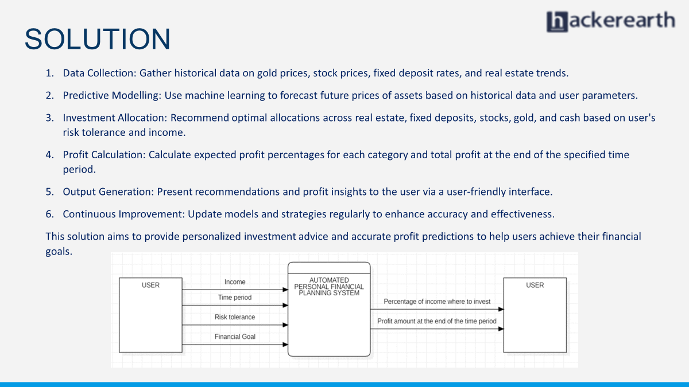
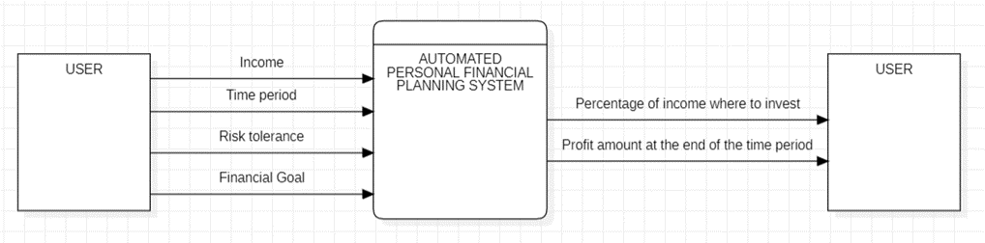
SOLUTION
Data Collection: Gather historical data on gold prices, stock prices, fixed deposit rates, and real estate trends.
Predictive Modelling: Use machine learning to forecast future prices of assets based on historical data and user parameters.
Investment Allocation: Recommend optimal allocations across real estate, fixed deposits, stocks, gold, and cash based on user's risk tolerance and income.
Profit Calculation: Calculate expected profit percentages for each category and total profit at the end of the specified time period.
Output Generation: Present recommendations and profit insights to the user via a user-friendly interface.
Continuous Improvement: Update models and strategies regularly to enhance accuracy and effectiveness.
This solution aims to provide personalized investment advice and accurate profit predictions to help users achieve their financial goals.

Slide 5
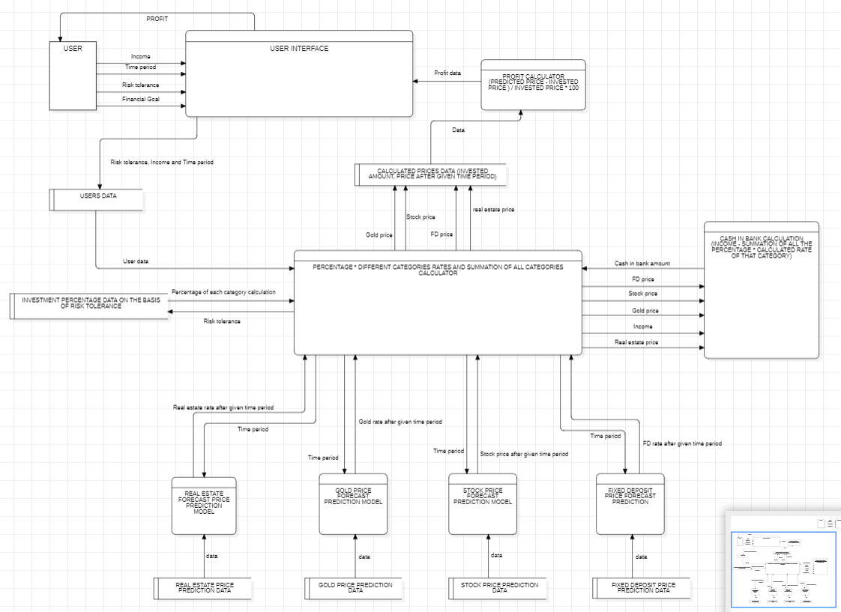
Methodology
Data Flow Diagram

Slide 6
SOCIETAL IMPACT/ NOVELTY
FUTURE SCOPE
Business relevance
Enhanced Scenario Planning and Forecasting
Real-time Financial Visibility and Risk Management
Optimisation
Scenario Planning
AI-powered Coaching
Scope for modification
Cybersecurity Advancements
Automated Goal Setting and Tracking
Language Processing
Increased Accessibility and Democratization of Financial Advice
Potential for Reduced Inequality
Efficiency and Reduced Errors
Focus on Proactive Strategies
Provides you personalized recommendations and helps you stay
Up-to-date with the current market trends . Also helps you become
Financially literate and helps you in handling your expenses .

Slide 7
THANK YOU
link

